Slide 1
New graphics (092619)
Edits to bottom control panel
Enlarge Search box
Replace quad spec with member counter box
Add BIY website button
Big and small top pull down info screen (change ‘main screen’ to ‘Info screen’)
Clean up data displays and navigation buttons on info screen
Goal to complete by Sep 30
Fonts need to be download： Lucida Bright and Matryoshka
Lucidia Bright on Windows does not work well????
Matryoshka may be a slightly different size on windows????

Slide 2





FONTS
Matryoshka Lucida Bright Nueva Std Calibri (Body) FZMiaoWuS-GB

Slide 3
Screen Shots
In case of missing text style

Slide 4
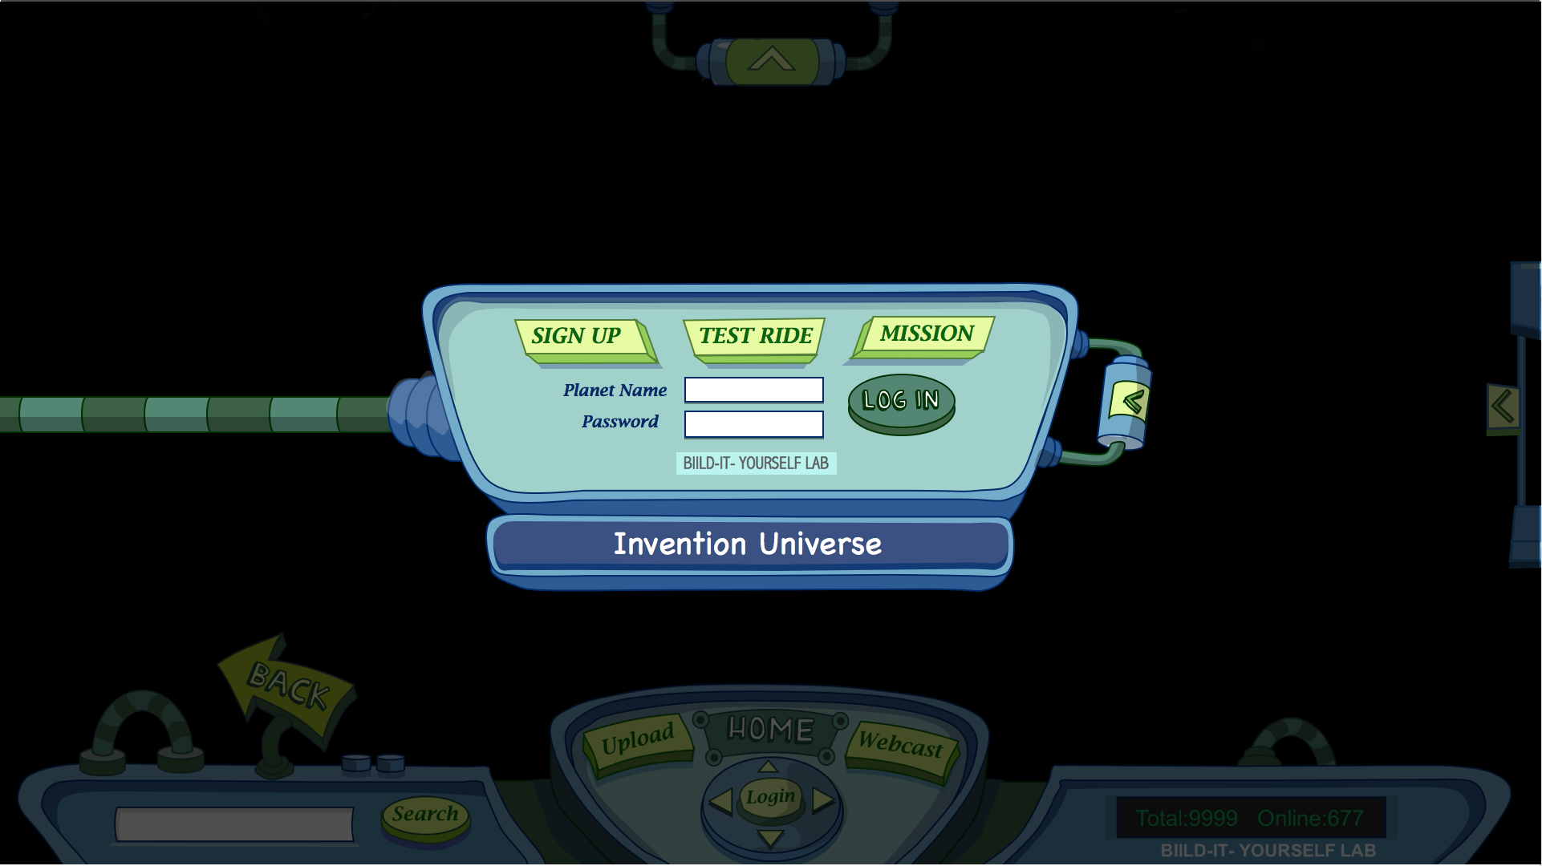
INDEX PAGE:
When kids click Invention Universe link, it pops up the login panel.
Every button has animated effects when it gets clicked.

Slide 5
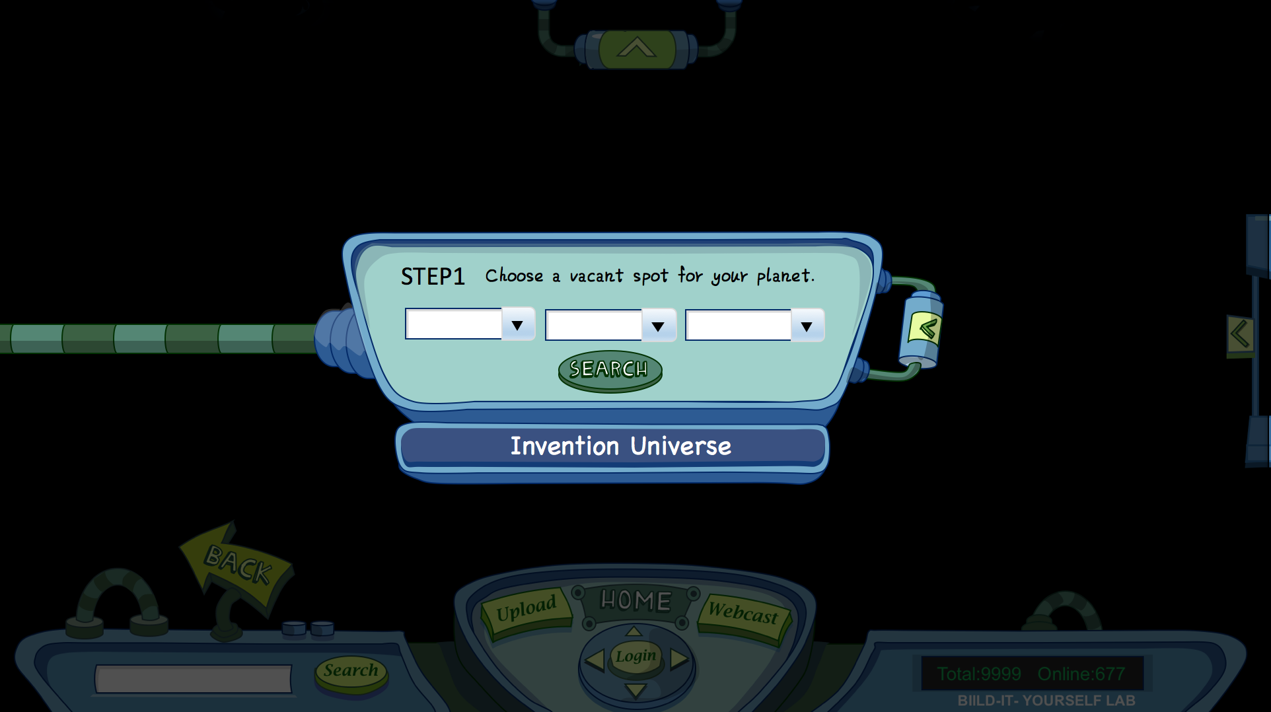
SIGN UP PAGE:
When kids click sign up, the step 1 will be choosing a vacant spot for their planets.
1st column is Sagittarius
2nd column is Quadrant
3rd column is galaxy
When kids click search, the screen will jump into certain galaxy with vacant spot in it.

Slide 6
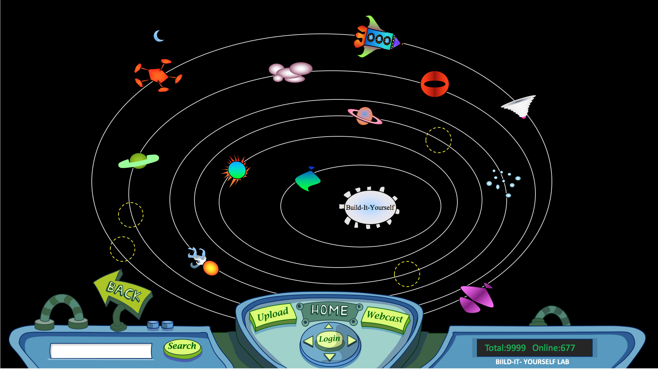
SIGN UP PAGE:
After clicking SEARCH button, screen shows vacant spots.
Kids selected the spot they want, another panel comes up.
Vacant spots

Slide 7
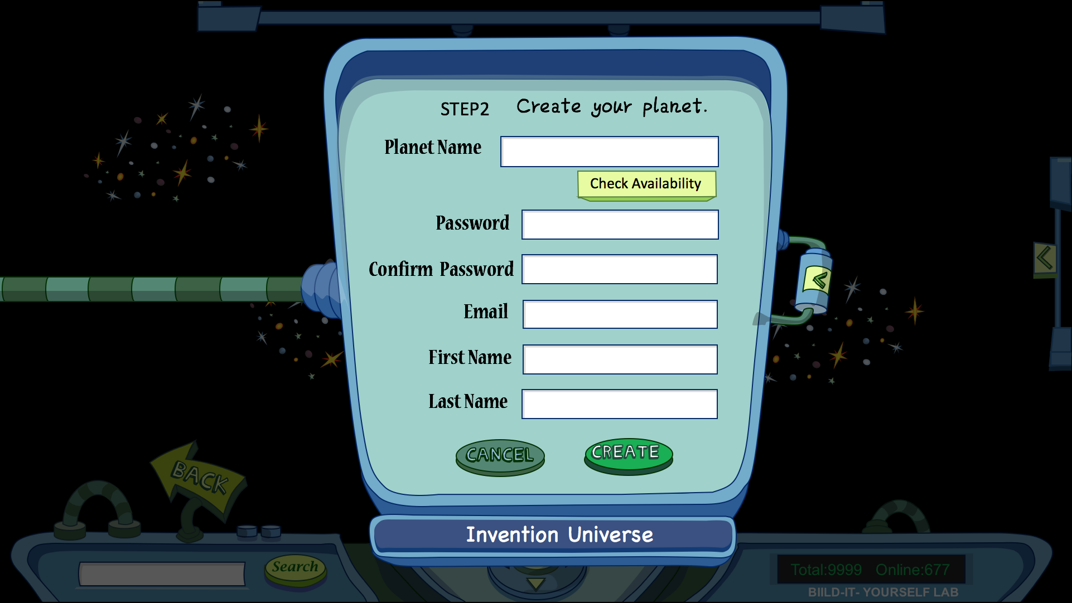
SIGN UP PAGE:
Kids will fill out the information columns for their new planets.
When kids click CANCEL, panel pops off, screen goes back to vacant spots.

Slide 8
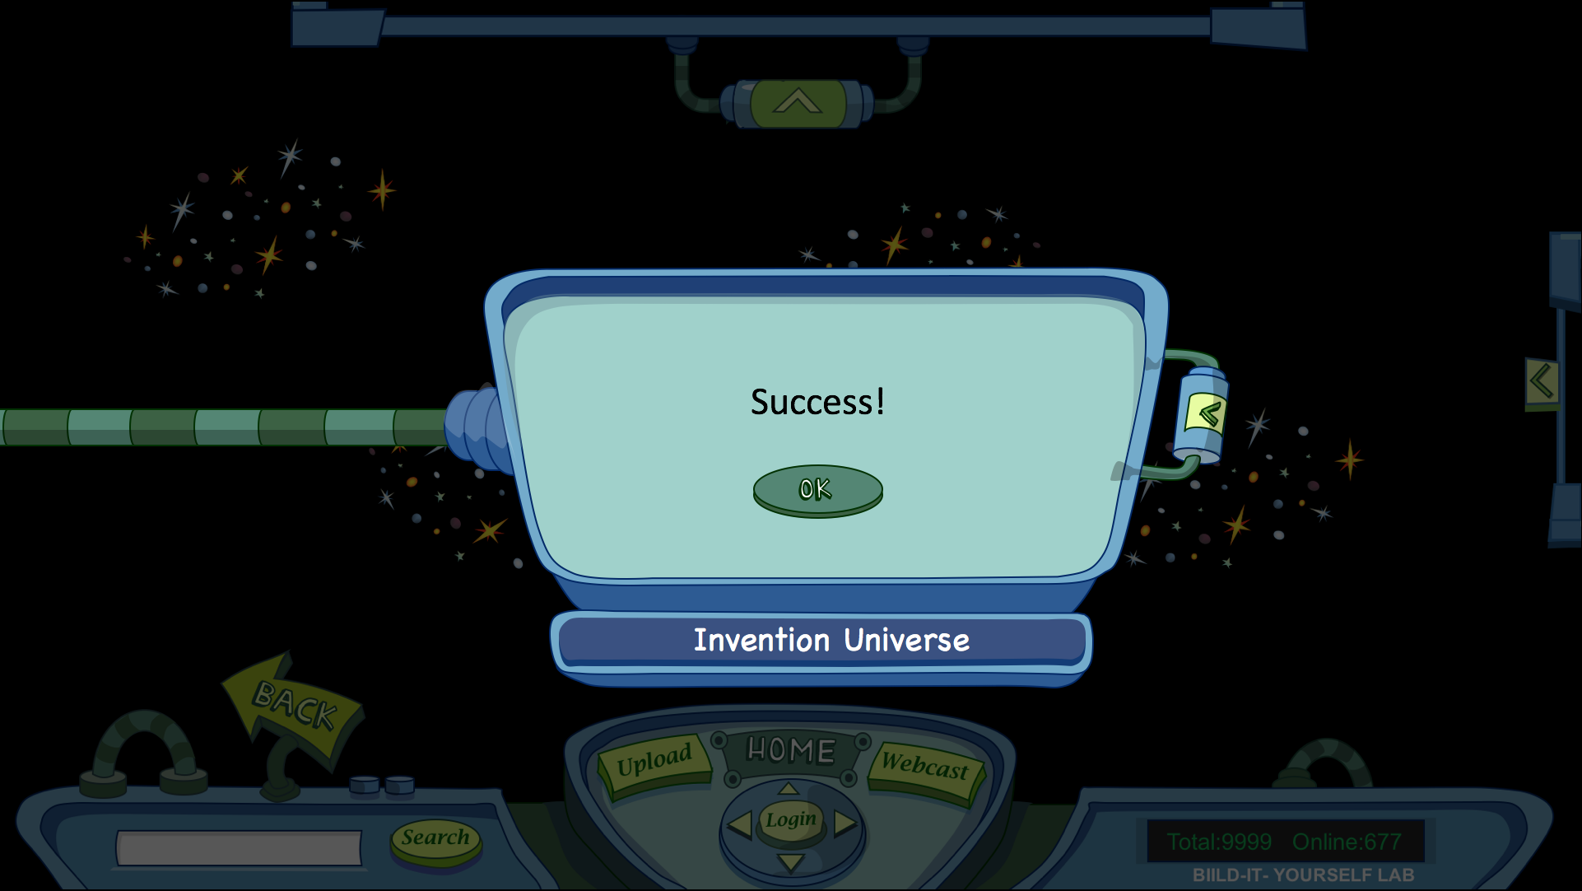
SIGN UP PAGE:
- When kids successfully created a new planet.

Slide 9
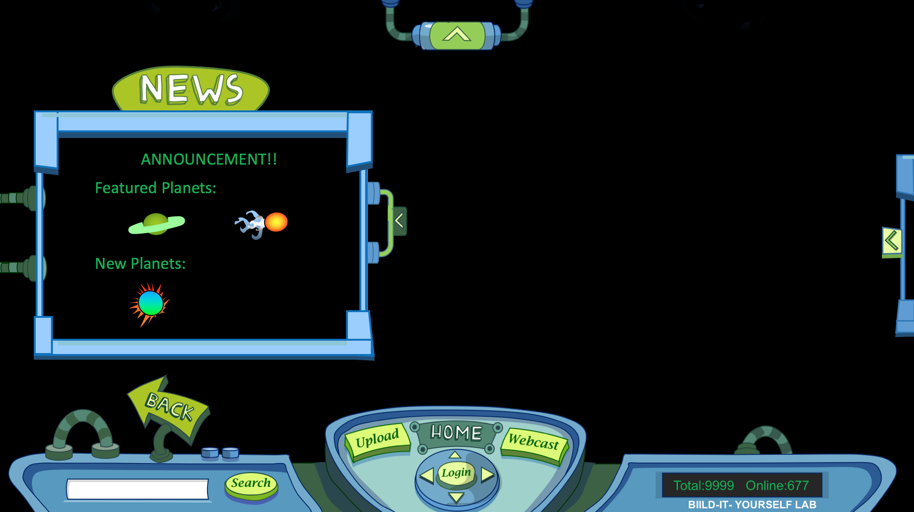
LOGGED IN PAGE:
Index page when kids logged in.
News Screen pops up to show the latest news.
Background is Sagittarius.

Slide 10
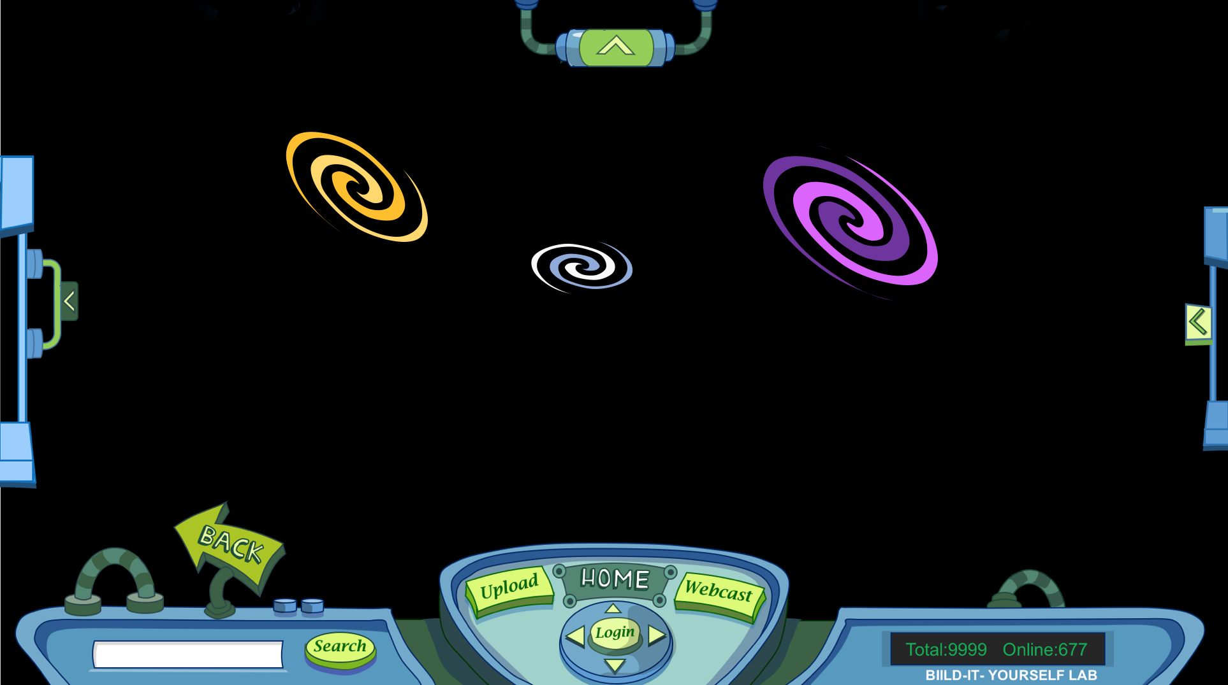
LOGGED IN PAGE:
Background is Quadrants.

Slide 11
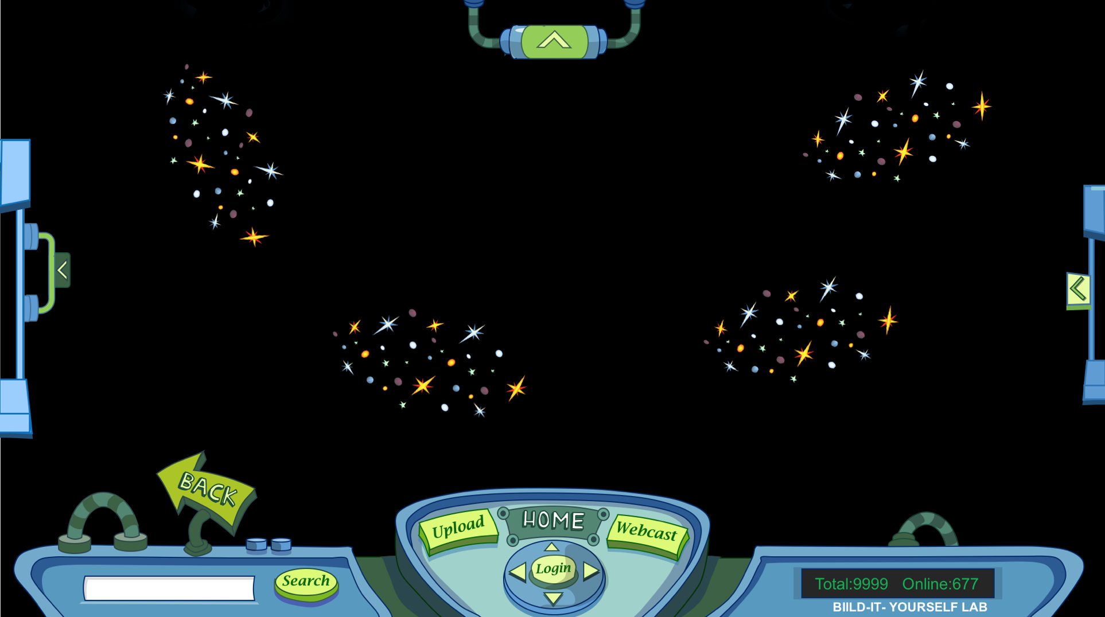
LOGGED IN PAGE:
Background is Galaxies.

Slide 12
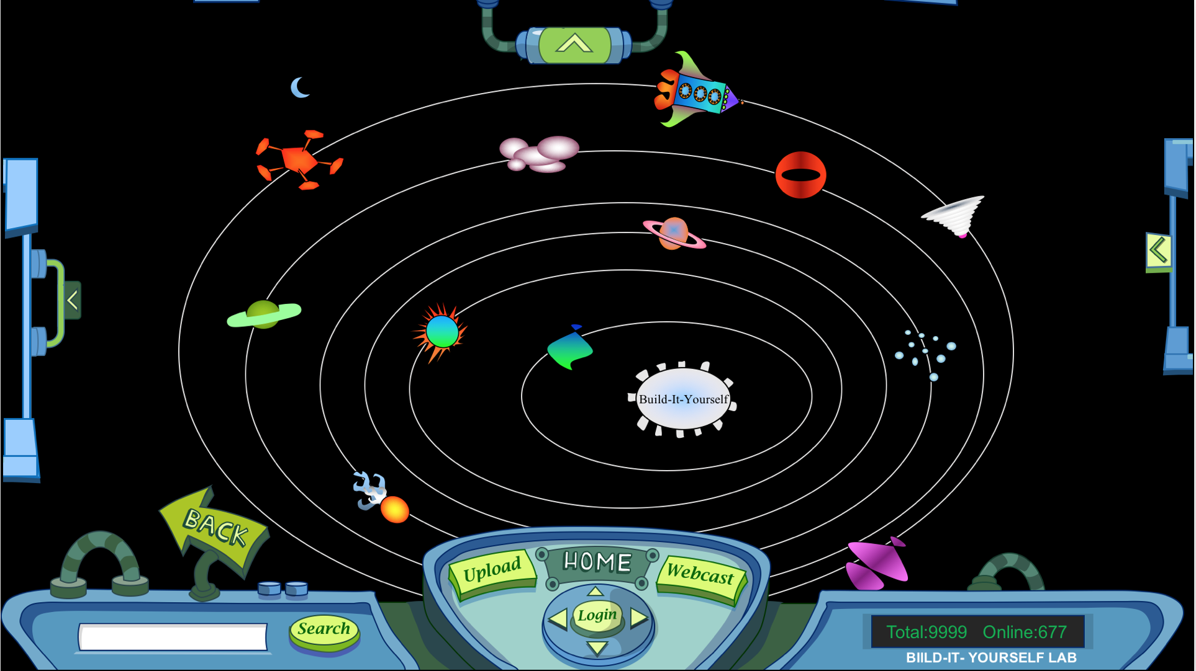
LOGGED IN PAGE:
Galaxy.

Slide 13
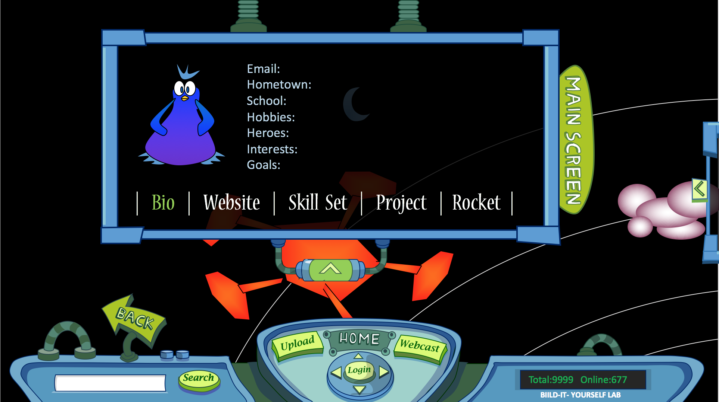
LOGGED IN PAGE:
When kids click one planet, top screen slide down.
Default screen will be Bio page

Slide 14
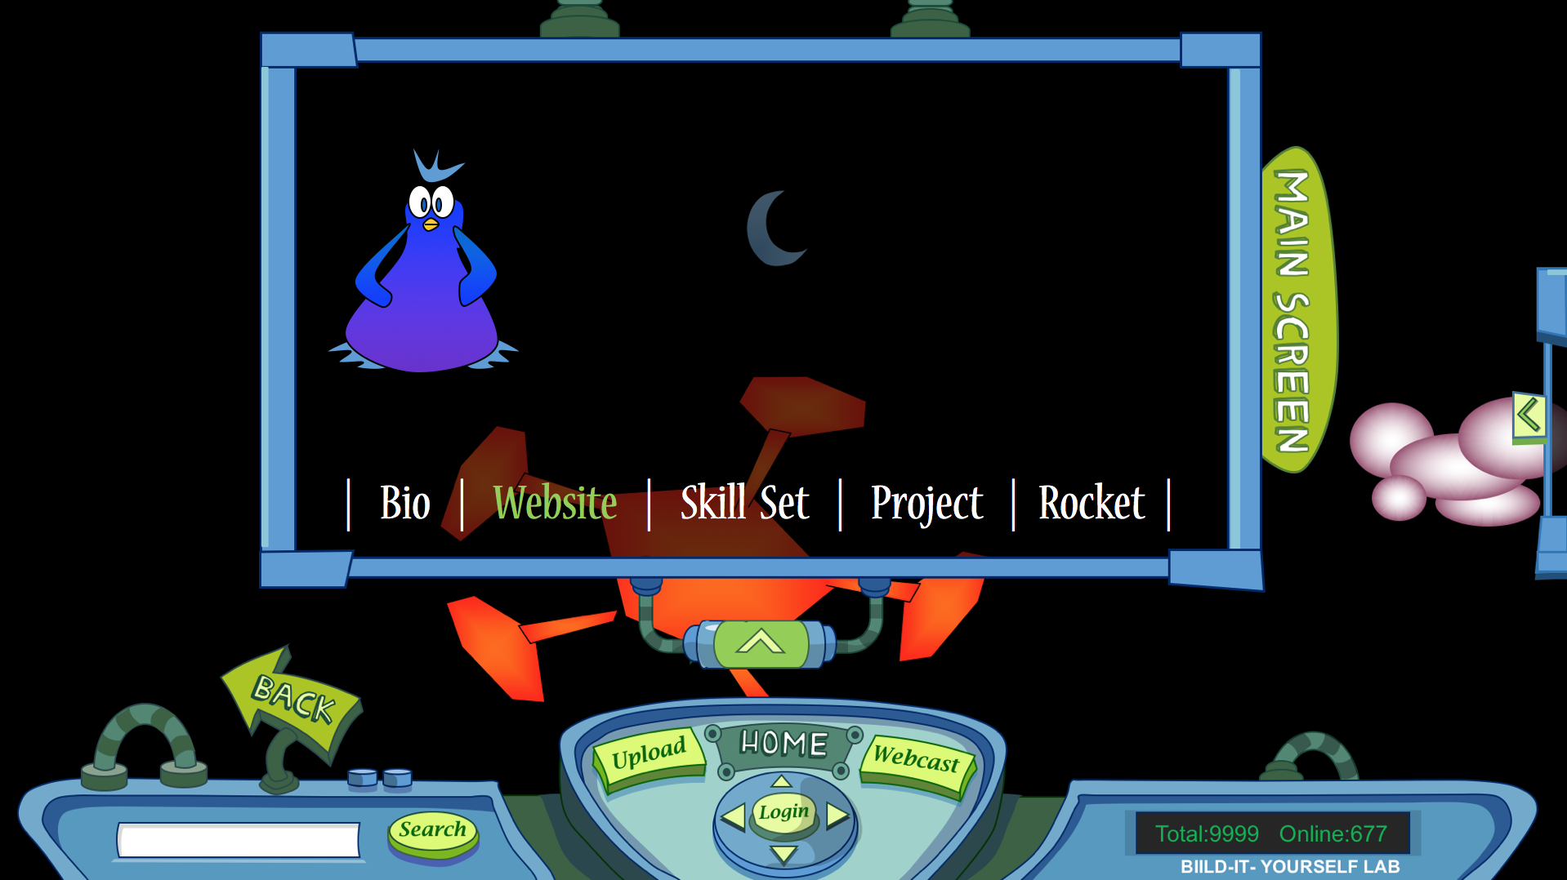
LOGGED IN PAGE:
Website page.

Slide 15

LOGGED IN PAGE:
Skill Set page.

Slide 16
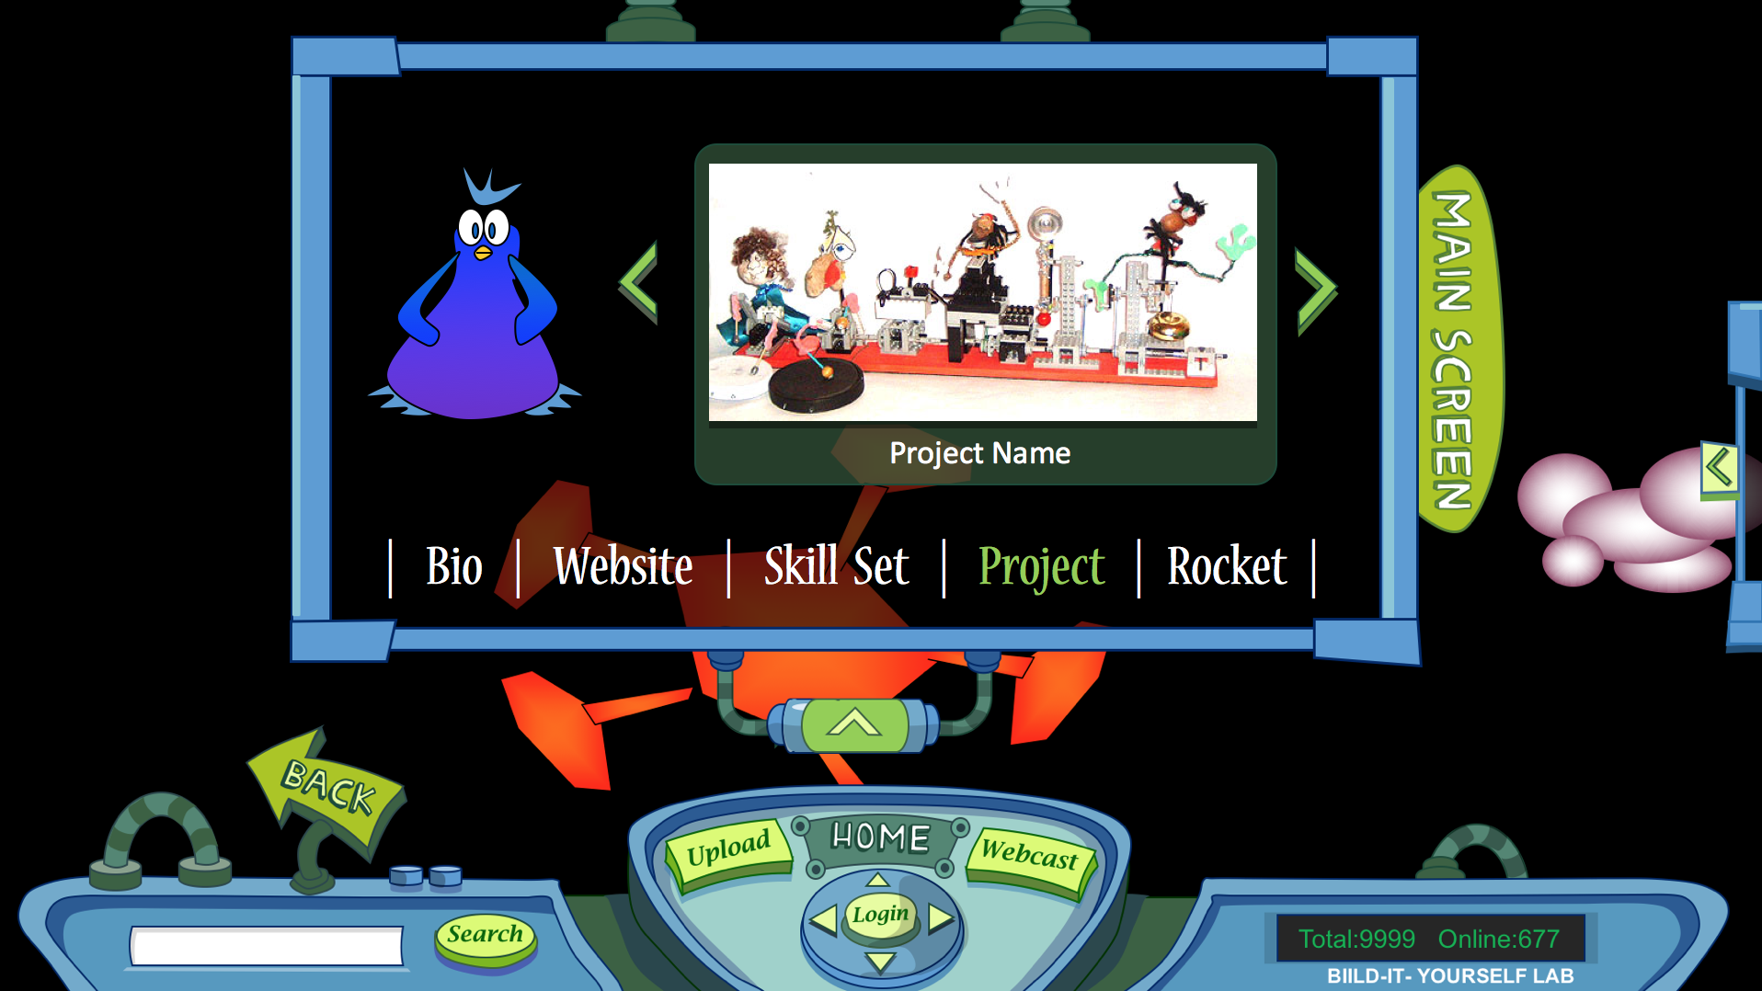
LOGGED IN PAGE:
Projects page.
Using arrows to slide left and right.

Slide 17
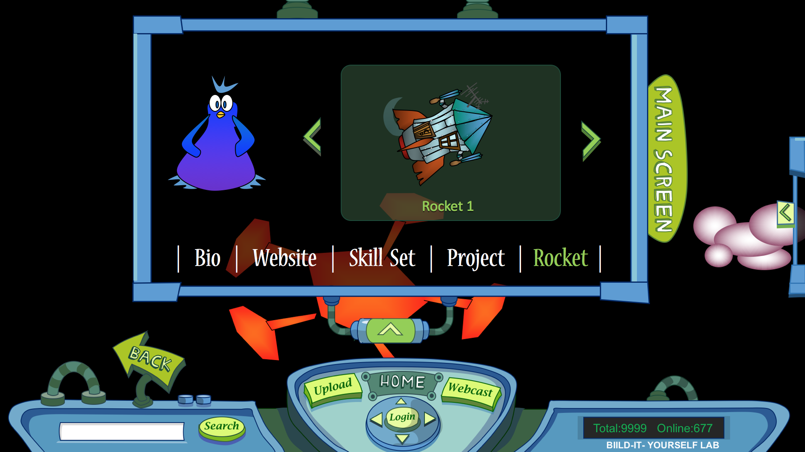
LOGGED IN PAGE:
Rocket page.
Using arrows to slide left and right.

Slide 18
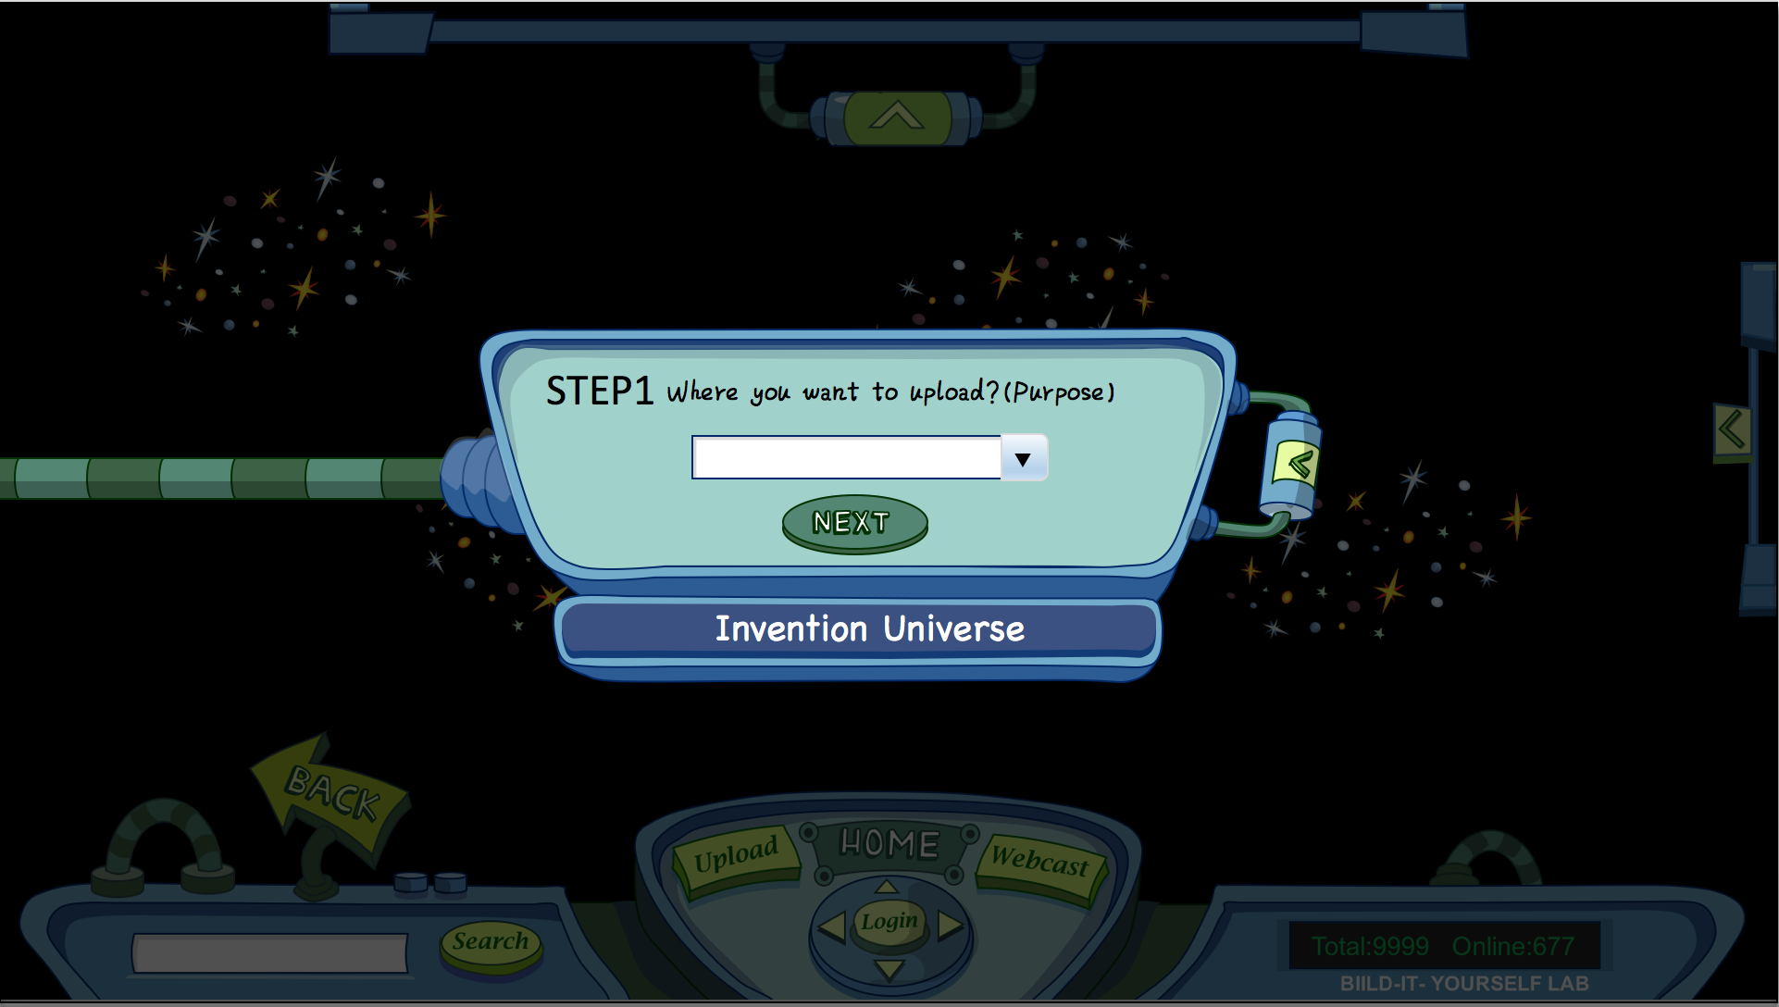
UPLOAD PAGE:
Step1 is to choose the location you want to upload.
Bio (text)
Website (link)
Skill Set (text)
Project (image)
Rocket (image)
Planet (image)
Avatar (image)

Slide 19
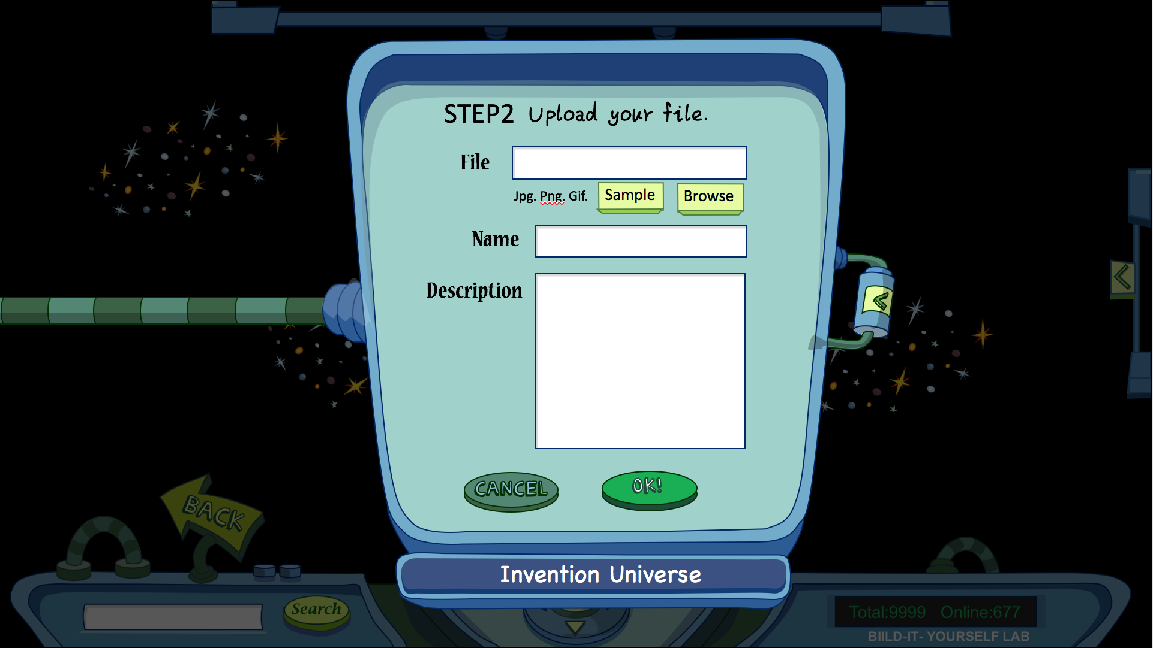
UPLOAD PAGE:
Step2 is to upload image file.
Project (image)
Rocket (image)
Planet (image)
Avatar (image)

Slide 20
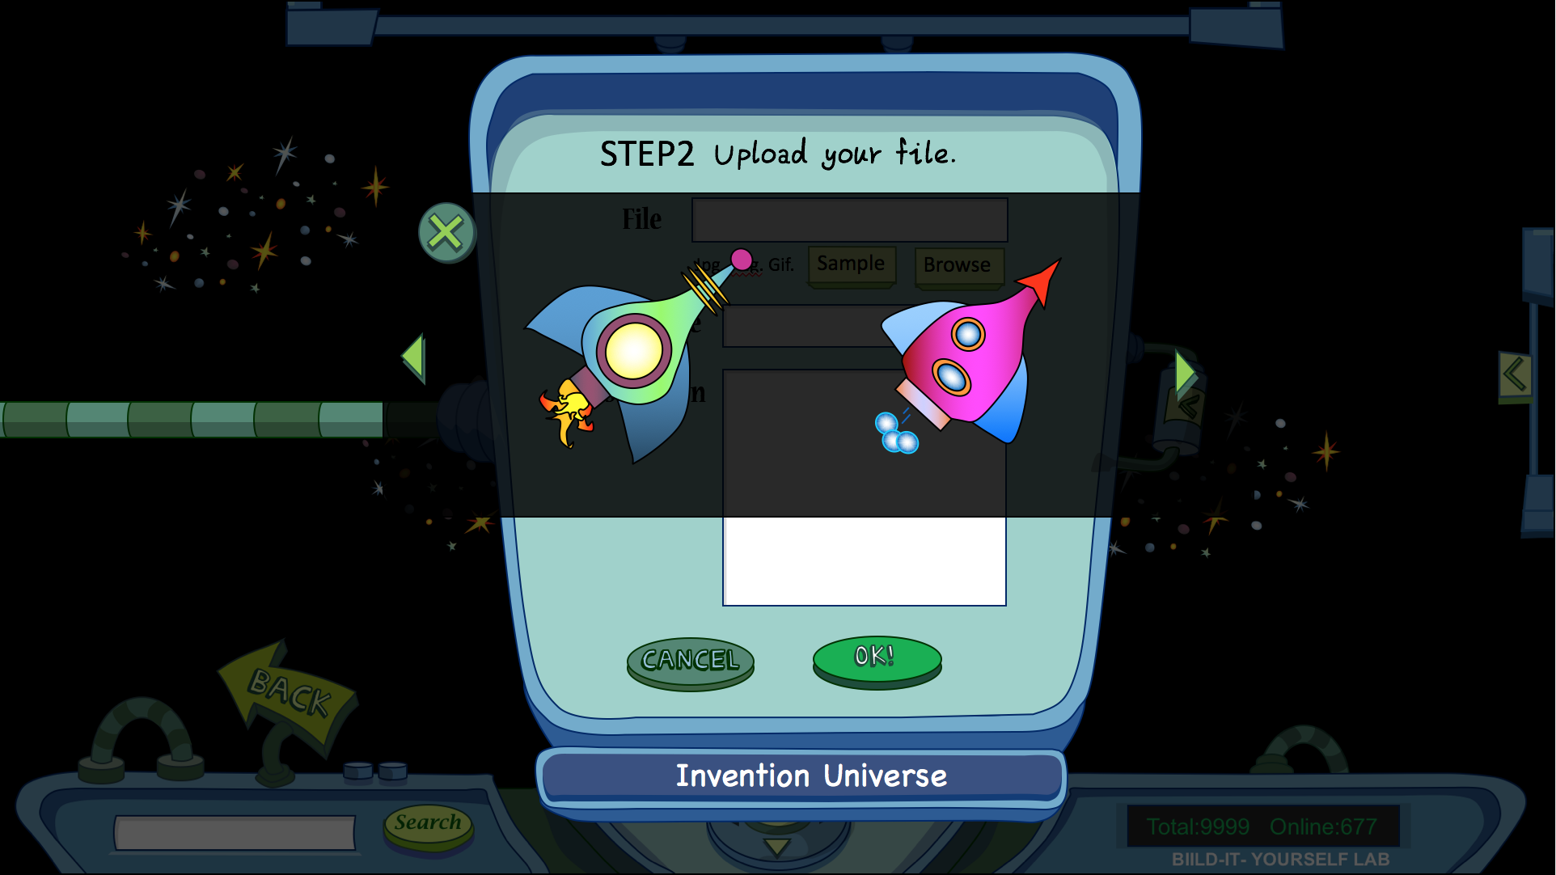
UPLOAD PAGE:
Step2 is to upload image file.
Rocket Samples(if kids don’t want to upload their own work)

Slide 21
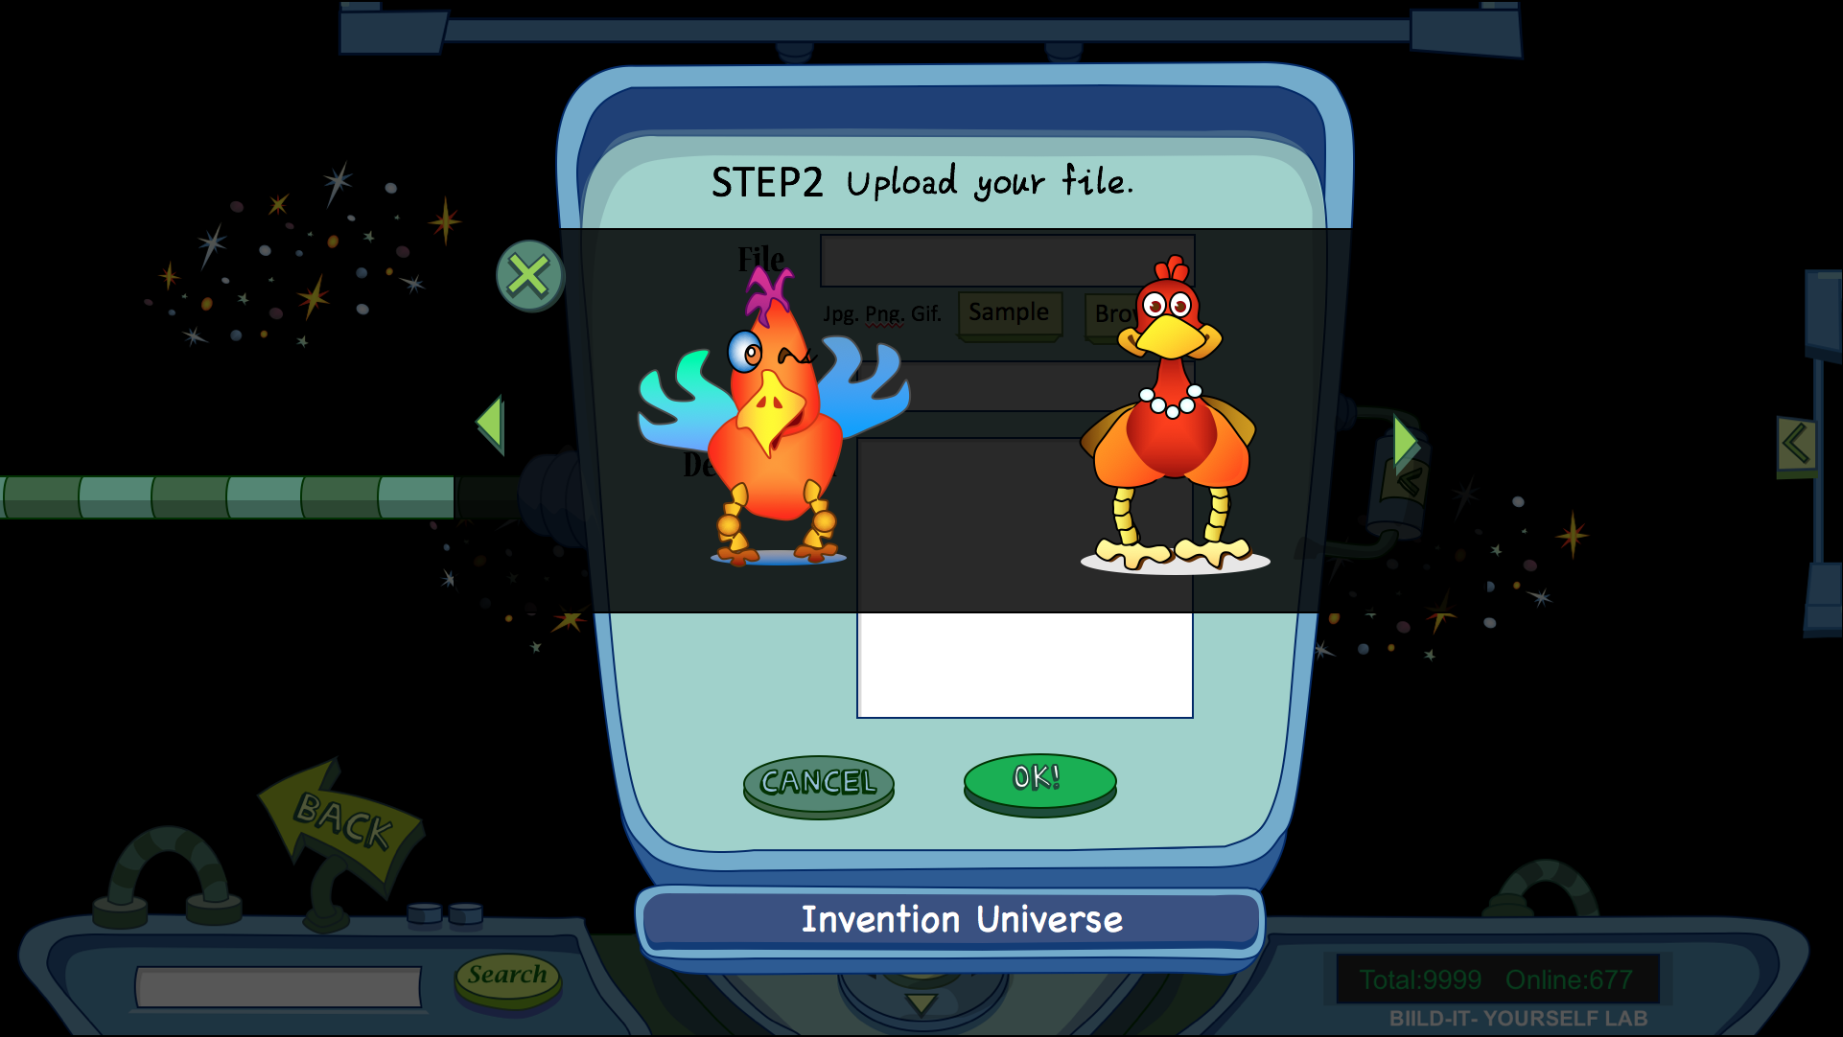
UPLOAD PAGE:
Step2 is to upload image file.
Avatar Samples(if kids don’t want to upload their own work)

Slide 22
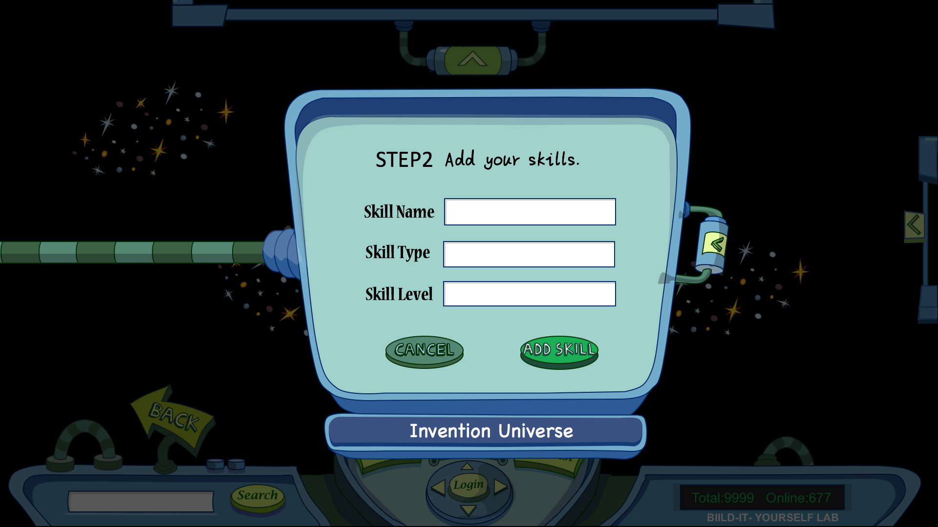
UPLOAD PAGE:
Step2 is to upload to Skill Set.

Slide 23
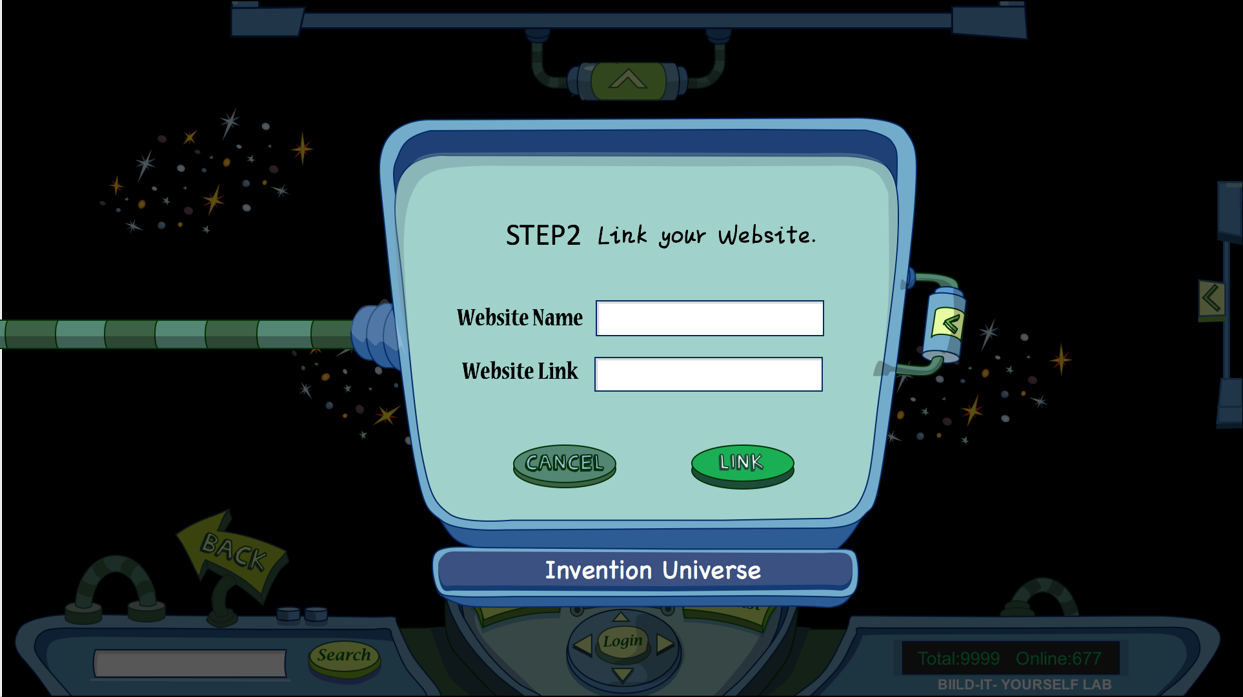
UPLOAD PAGE:
Step2 is to link a Website.

Slide 24
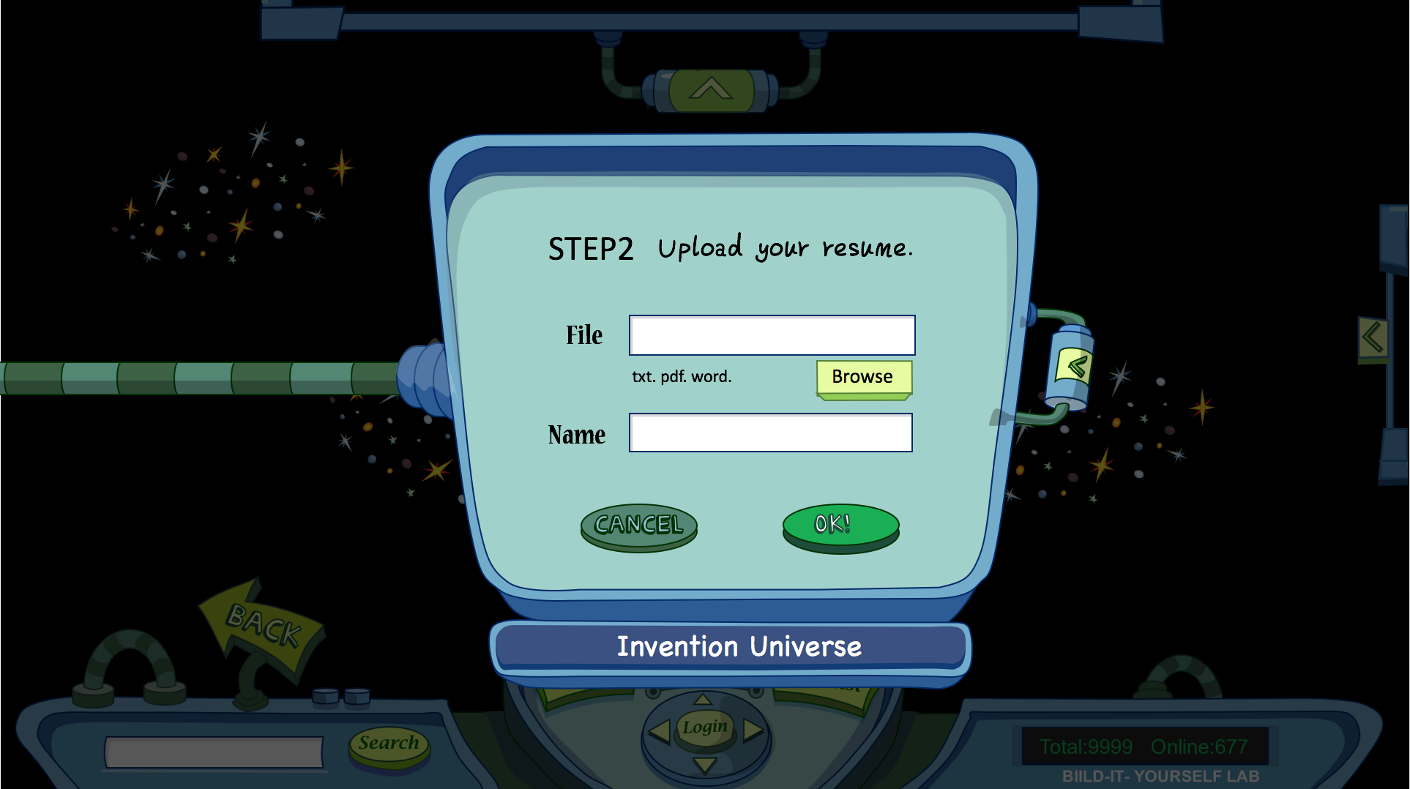

Slide 25


Slide 26
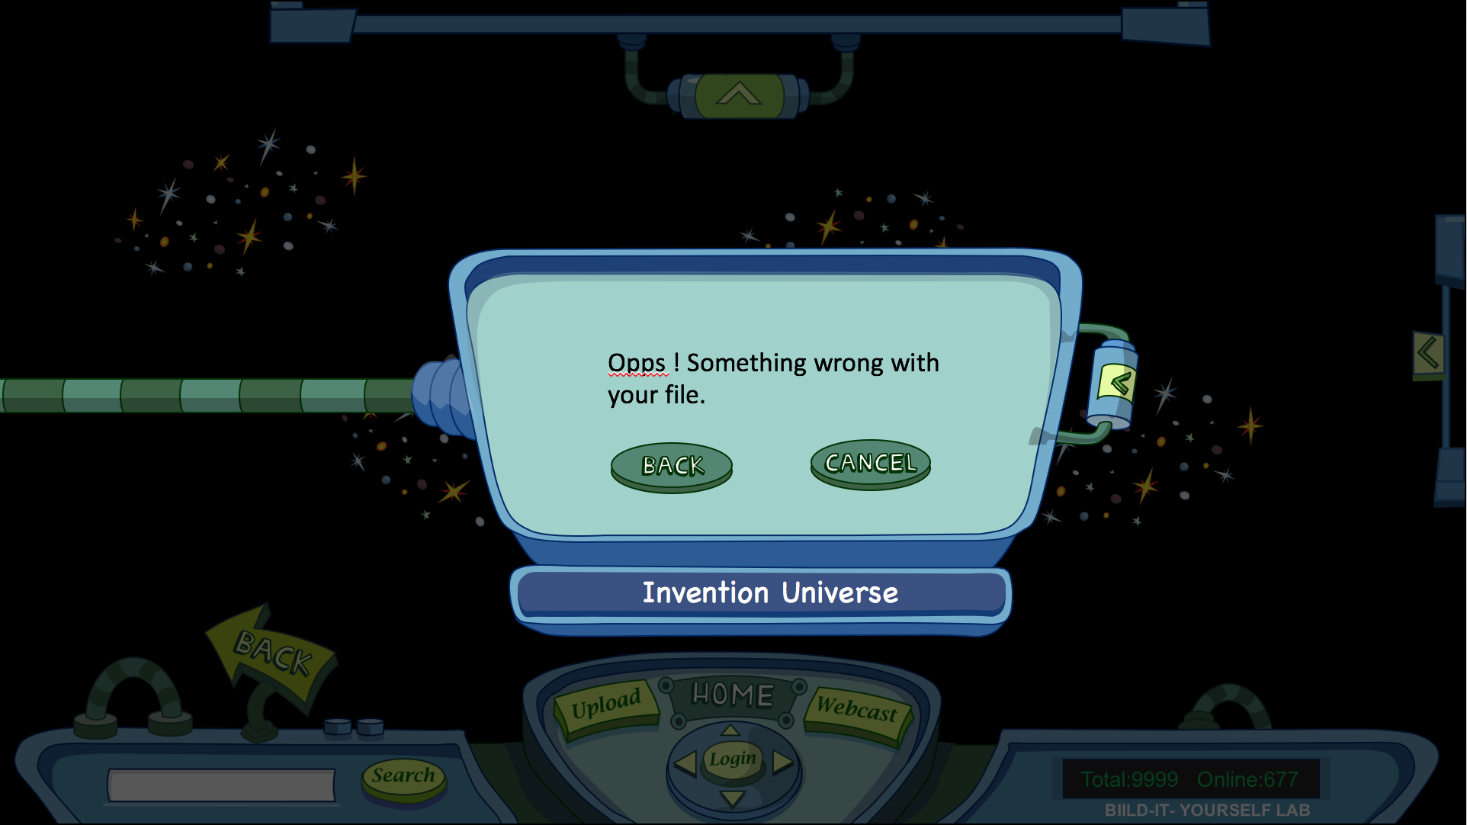

Slide 27
Original Files

Slide 28
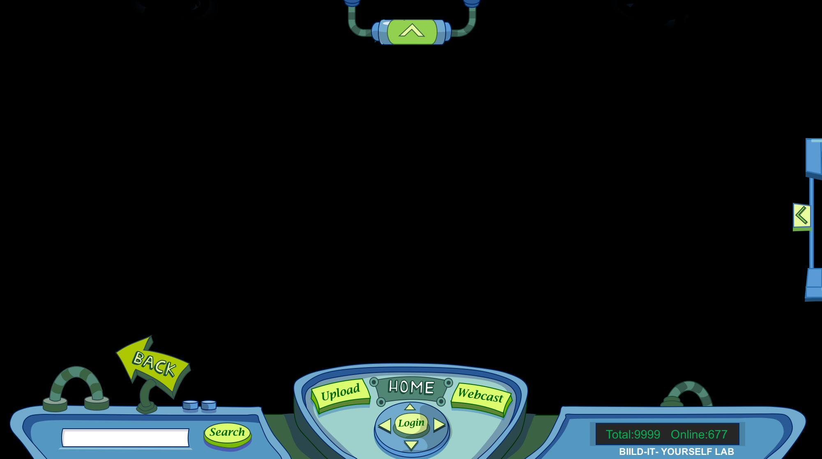
SIGN UP
TEST RIDE
MISSION
Planet Name
LOG IN
<
Password
BIILD-IT- YOURSELF LAB
Invention Universe
Notes:
Invention Universe Index

Slide 29
STEP1
Choose a vacant spot for your planet.
<
search
Invention Universe
Notes:
Register Index

Slide 30
Build-It-Yourself
BACK
HOME
Upload
Webcast
Search
Login
Total:9999 Online:677
BIILD-IT- YOURSELF LAB

Slide 31
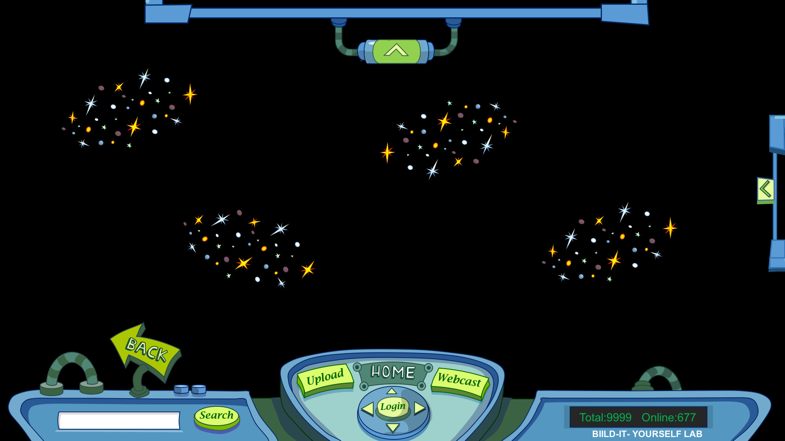
STEP2
Create your planet.
Planet Name
Check Availability
Password
Confirm Password
<
Email
First Name
Last Name
CANCEL
Create
Invention Universe

Slide 32
Success!
<
ok
Invention Universe
Notes:
Upload for skill set

Slide 33
News
ANNOUNCEMENT!!
Featured Planets:
New Planets:

Slide 34


Slide 35


Slide 36

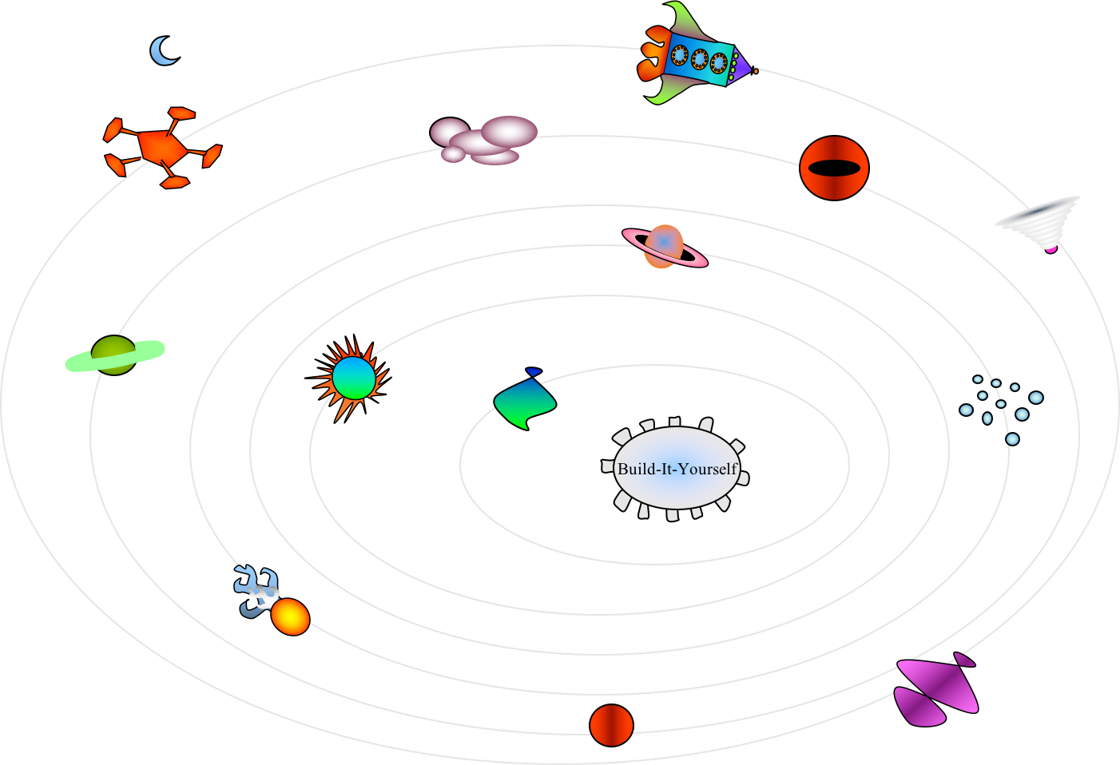

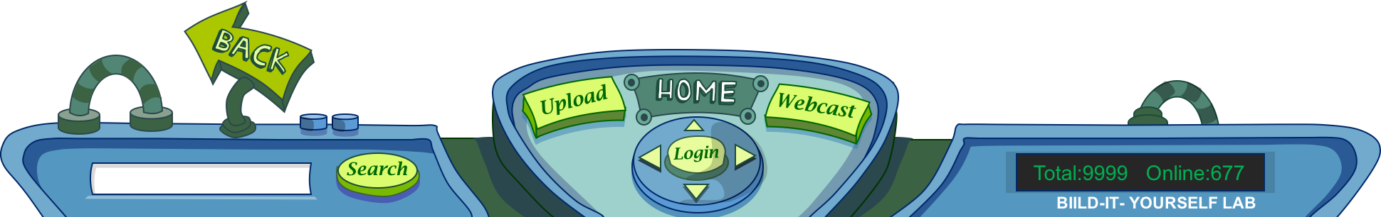

Slide 37

Email:
Hometown:
School:
Hobbies:
Heroes:
Interests:
Goals:
Main Screen
| Bio | Website | Skill Set | Project | Rocket |
BACK
HOME
Upload
Webcast
Search
Login
Total:9999 Online:677
BIILD-IT- YOURSELF LAB

Slide 38
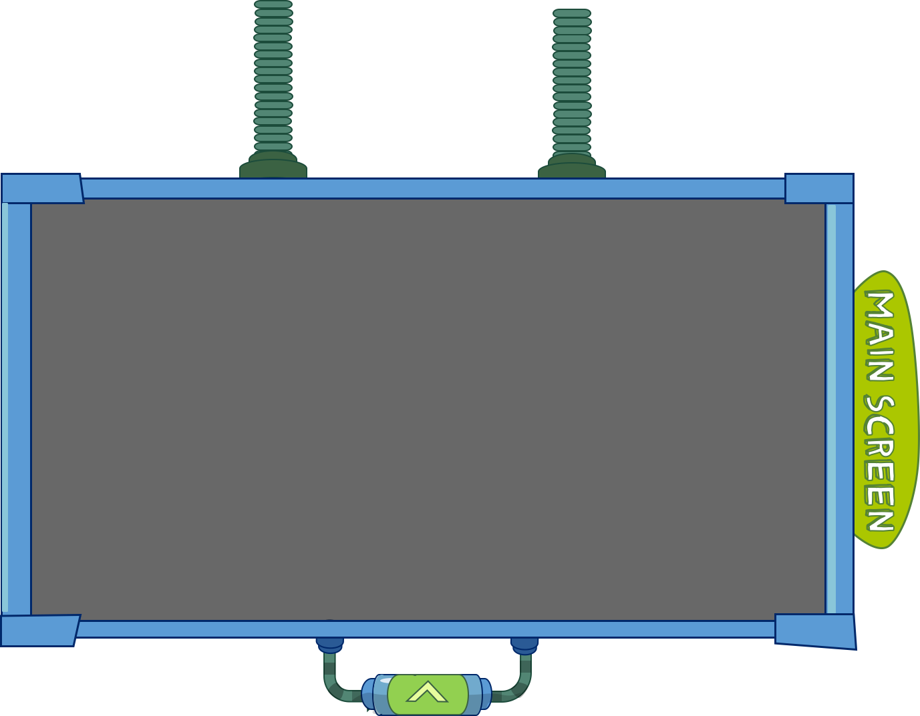
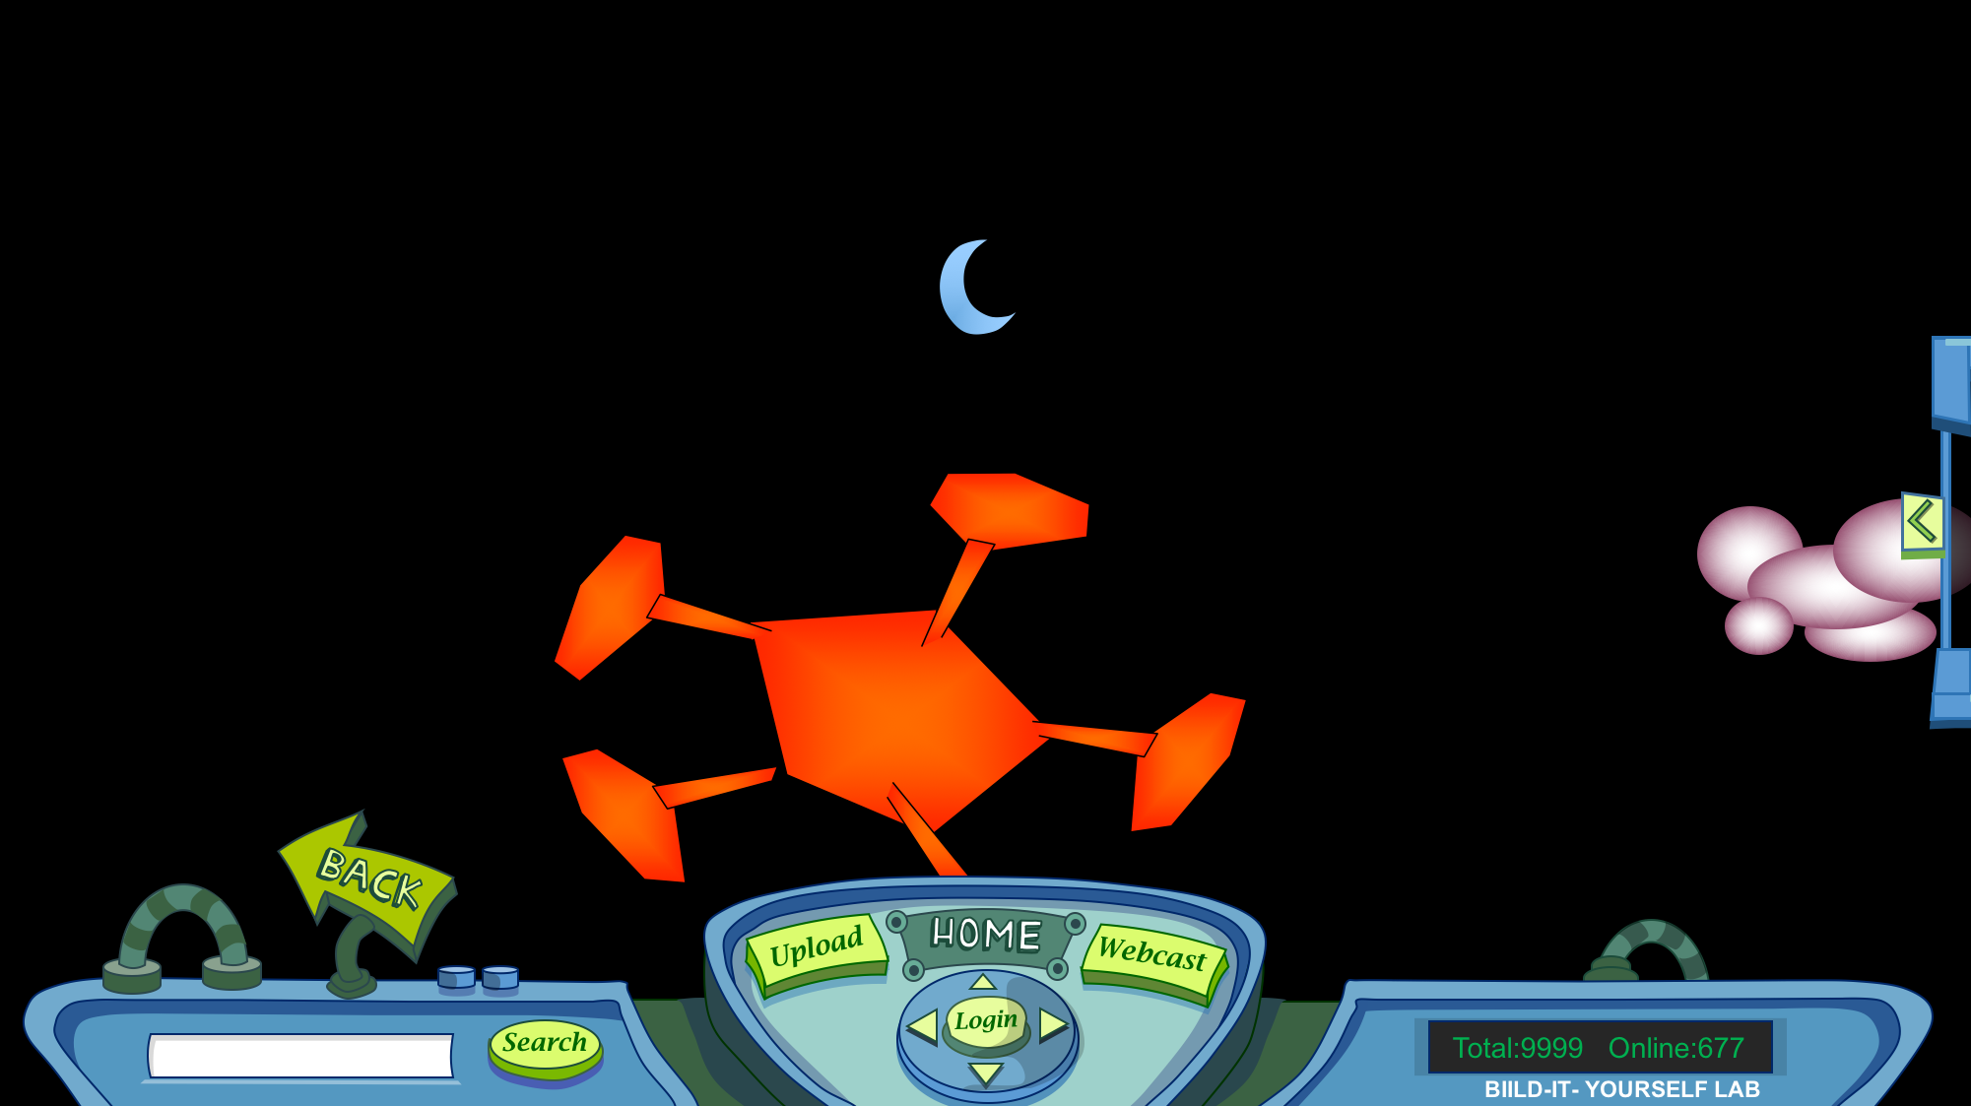
| Bio | Website | Skill Set | Project | Rocket |

Slide 39
Name Type Level
| Bio | Website | Skill Set | Project | Rocket |

Slide 40
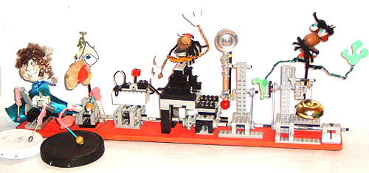
Project Name
| Bio | Website | Skill Set | Project | Rocket |

Slide 41
Rocket 1
| Bio | Website | Skill Set | Project | Rocket |

Slide 42
STEP1
Where you want to upload?(Purpose)
<
next
Invention Universe
Notes:
Content in blanked bar:
Planet (img)
Avatar (img)
Bio (file)
Website (link)
Skill set (text)
Project (multi)
Rocket (img)

Slide 43
STEP2
Upload your file.
File
Jpg. Png. Gif.
Sample
Browse
Name
Description
<
CANCEL
OK!
Invention Universe
Notes:
Upload for images

Slide 44
STEP2
Upload your file.
File
Jpg. Png. Gif.
Sample
Browse
Name
Description
<
CANCEL
OK!
Invention Universe
Notes:
Upload for images

Slide 45
STEP2
Upload your file.
File
Jpg. Png. Gif.
Sample
Browse
Name
Description
<
CANCEL
OK!
Invention Universe
Notes:
Upload for images

Slide 46
STEP2
Add your skills.
Skill Name
<
Skill Type
Skill Level
CANCEL
Add Skill
Invention Universe
Notes:
Upload for skill set

Slide 47
STEP2
Link your Website.
Website Name
<
Website Link
CANCEL
Link
Invention Universe
Notes:
Upload for skill set

Slide 48
STEP2
Upload your resume.
File
<
txt. pdf. word.
Browse
Name
CANCEL
ok!
Invention Universe
Notes:
Upload for skill set

Slide 49
Success!
<
ok
Invention Universe
Notes:
Upload for skill set

Slide 50
Opps ! Something wrong with your file.
<
back
cancel
Invention Universe
Notes:
Upload for skill set

Slide 51
Mini map
Draw character ‘ > ‘
Make top and bottom symetric ????

Slide 52
SIGN UP
TEST RIDE
MISSION
Planet Name
LOG IN
<
Password
BIILD-IT- YOURSELF LABORATORY
Invention Universe
BACK
HOME
Upload
Webcast
Search
Login
Total:9999 Online:677
BIILD-IT- YOURSELF LAB

Slide 53
News
Redesign screen shape so all three screens are a little different ???? Maybe not ????
Put dark green square in screen center, not transparency.
Redesign handle

Slide 54
News

Slide 55
SIGN UP
TEST RIDE
MISSION
Planet Name
LOG IN
<
Password
BIILD-IT- YOURSELF LABORATORY
Invention Universe
Steve …
Do we need to create two button animations or can you do this with CSS?

Slide 56
SIGN UP
TEST RIDE
MISSION
Planet Name
LOG IN
<
Password
BIILD-IT- YOURSELF LABORATORY
Invention Universe

Slide 57
BACK
HOME
Upload
Webcast
Search
Login
BIILD-IT- YOURSELF LABORATORY
Put transparency in cable area.

Slide 58
BACK
Upload
HOME
Webcast
Search
Login
BIILD-IT- YOURSELF LABORATORY
BACK
Upload
HOME
Webcast
Login
Member counter
Search
BIILD-IT- YOURSELF LABORATORY

Slide 59
BACK
HOME
Upload
Webcast
Search
Logout
BIILD-IT- YOURSELF LABORATORY

Slide 60
Main Screen
Vary pull down cable …

Slide 61
Main Screen
Vary pull down cable …

Slide 62
SIGN UP
TEST RIDE
MISSION
Planet Name
LOG IN
<
Password
BIILD-IT- YOURSELF LAB
Invention Universe

Slide 63
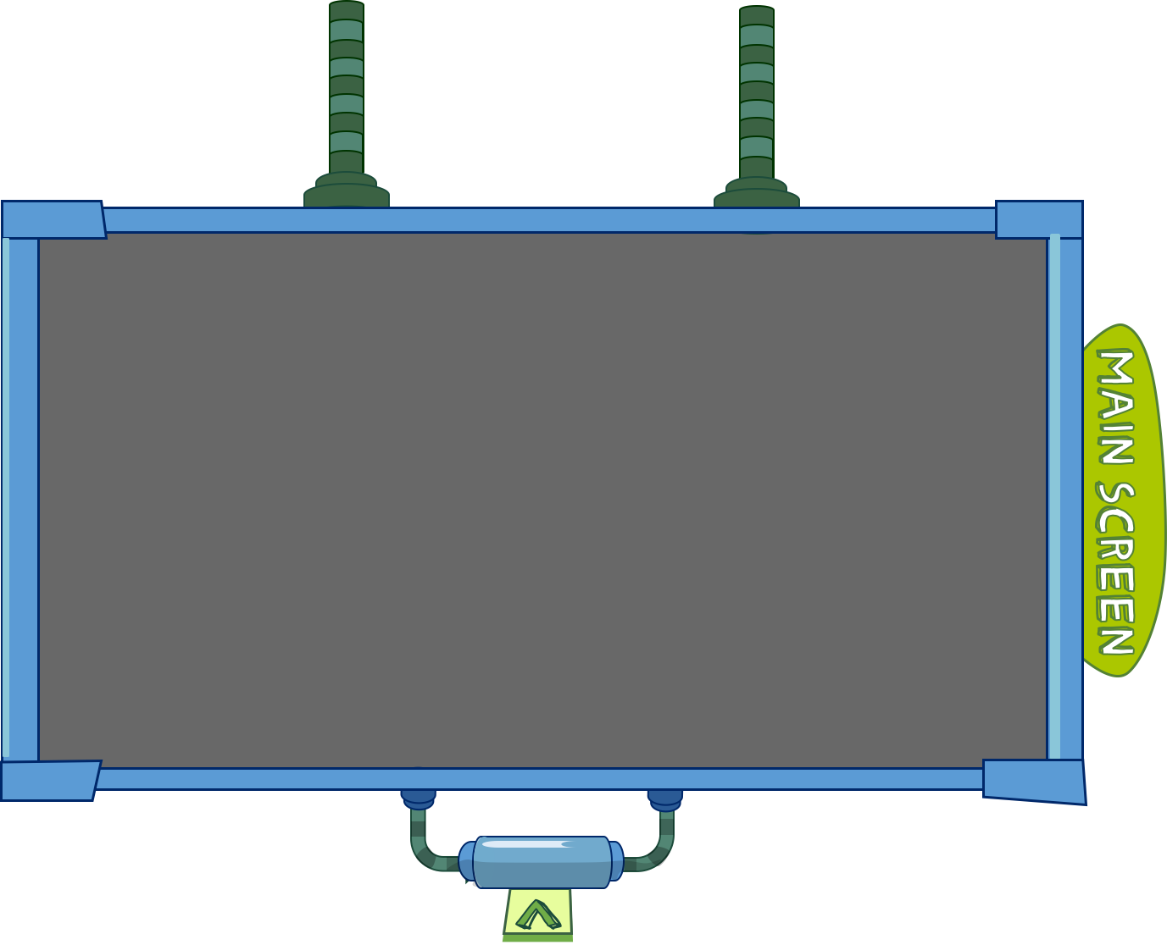
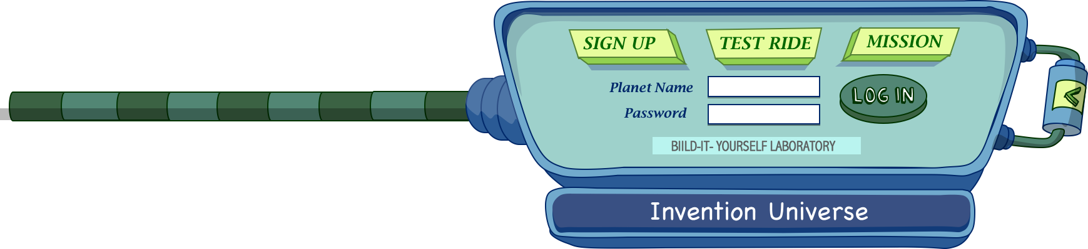

Make ‘>’ and ‘<‘ character
To place easier.
Make BIY button
Make big and small version of Main Screen

